Slide 1



Intel® GenAI Hackathon
Team Name : Tech Predators
Problem Statement : AI for Social Impact

Slide 2

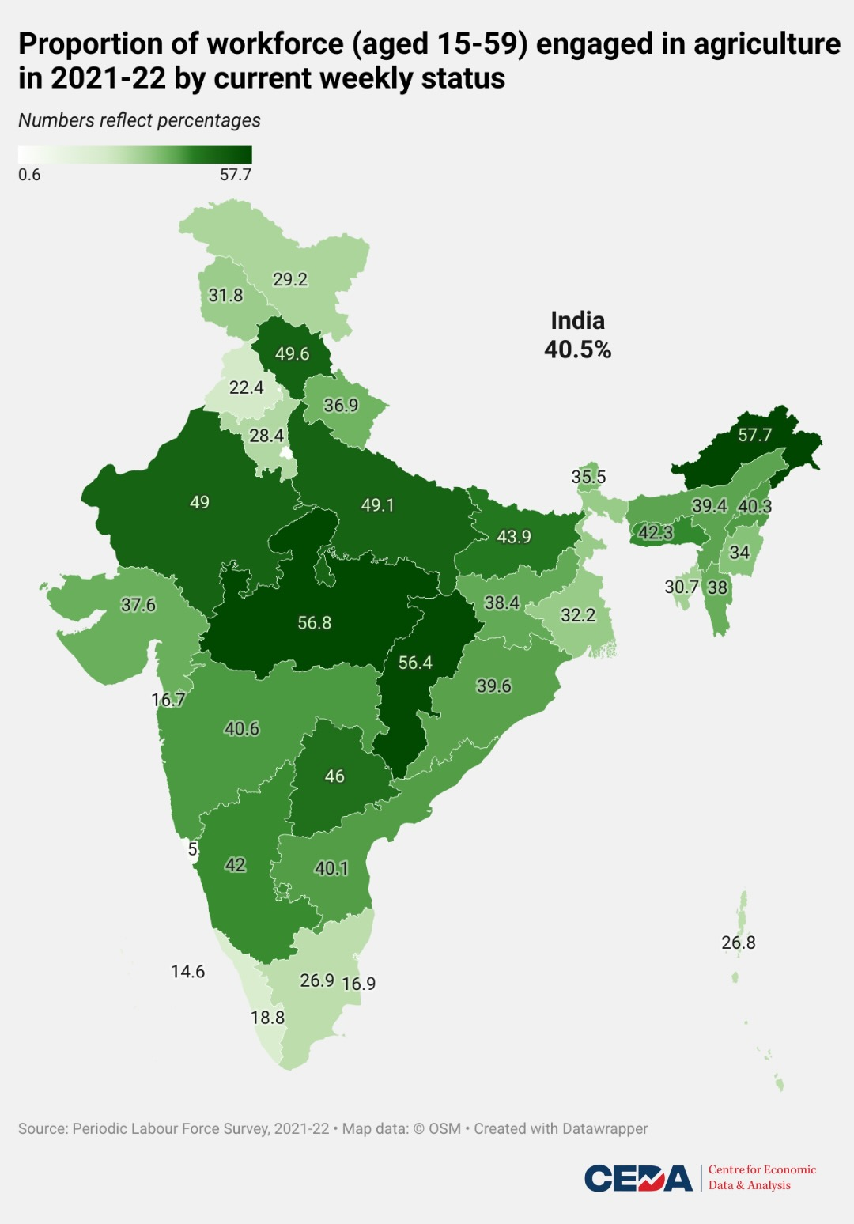

Problem Statement
Agriculture in India sustains food security amidst population growth, contributing significantly to GDP and income. It employs a vast workforce, particularly in rural areas, supporting livelihoods and reducing poverty.
Enhanced agricultural productivity is crucial for addressing the needs of India's growing population, fostering economic growth, and alleviating income disparities.
Factors like climate change, urbanization, and resource depletion exacerbate crop production issues, leading to yield losses and food insecurity. As farmers struggle to combat emerging pests and diseases amidst these challenges, timely detection and management become imperative.
As a consequence, farmers face heightened risks of yield loss and decreased incomes, exacerbating food insecurity and economic instability.
Agriculture profoundly impacts society by shaping livelihoods, food security, and cultural identity. It provides employment, particularly in rural areas, reducing poverty and fostering community resilience.

Slide 3
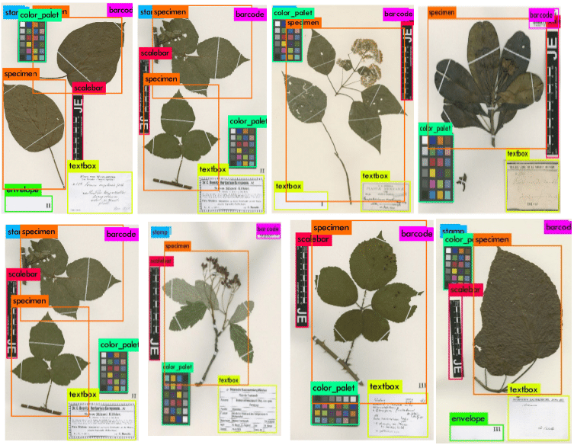
Unique Idea Brief (Solution)
Developing a website to detect diseases in crops by analyzing crop leaves, utilizing machine learning and image processing techniques that can empower farmers to detect and diagnose diseases early, enabling timely intervention and preventing significant crop losses. By providing farmers with a tool to accurately identify and manage plant diseases, this solution can enhance agricultural productivity, safeguard food security, and reduce their expenses. Additionally, the implementation of such technology can foster sustainable agricultural practices, aligning with broader environmental and socio-economic development goals.
Through our solution, we also aim to increase awareness among farmers about crop diseases by sharing disease-related information and curing methods.
Future Aspect of Solution:
To implement YOLOv8 to get real-time monitoring in leaf disease detection.

Slide 4


Features Offered
Leaf disease detection in just one click
93% accuracy
Awareness about diseases and their cure
5 types of disease detection
Multiple crop disease detection

Slide 5
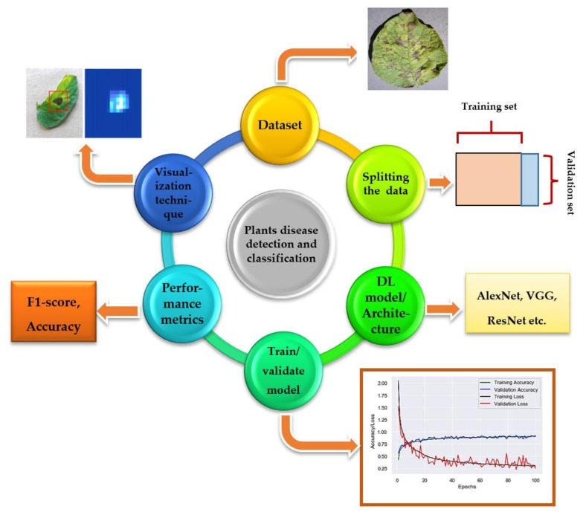
Process flow

Slide 6
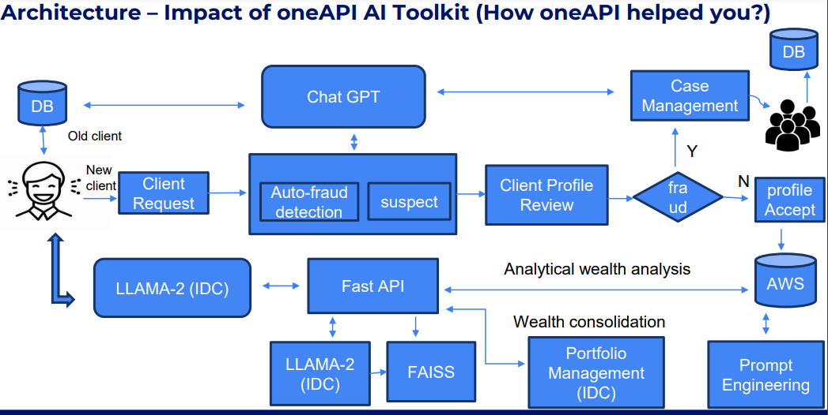
Architecture Diagram (Attached below for reference)

Slide 7

Technologies used (Mark down oneAPI AI Analytics libraries used)
Tech stacks:-Website Development, Python, Machine learning, Convolution neural networks(CNN), Tensorflow ,Keras, Pandas, Numpy, Fast API, Intel developer cloud(IDC)
Intel one API AI analytics Library-: intel-TensorFlow
Intel TensorFlow is a version of TensorFlow optimized for Intel architecture, enhancing performance on Intel processors. It leverages Intel's advanced technologies like AVX-512 instructions and optimizations for deep learning workloads. These optimizations accelerate neural network training and inference tasks, improving efficiency and enabling faster development of AI applications on Intel platforms.

Slide 8
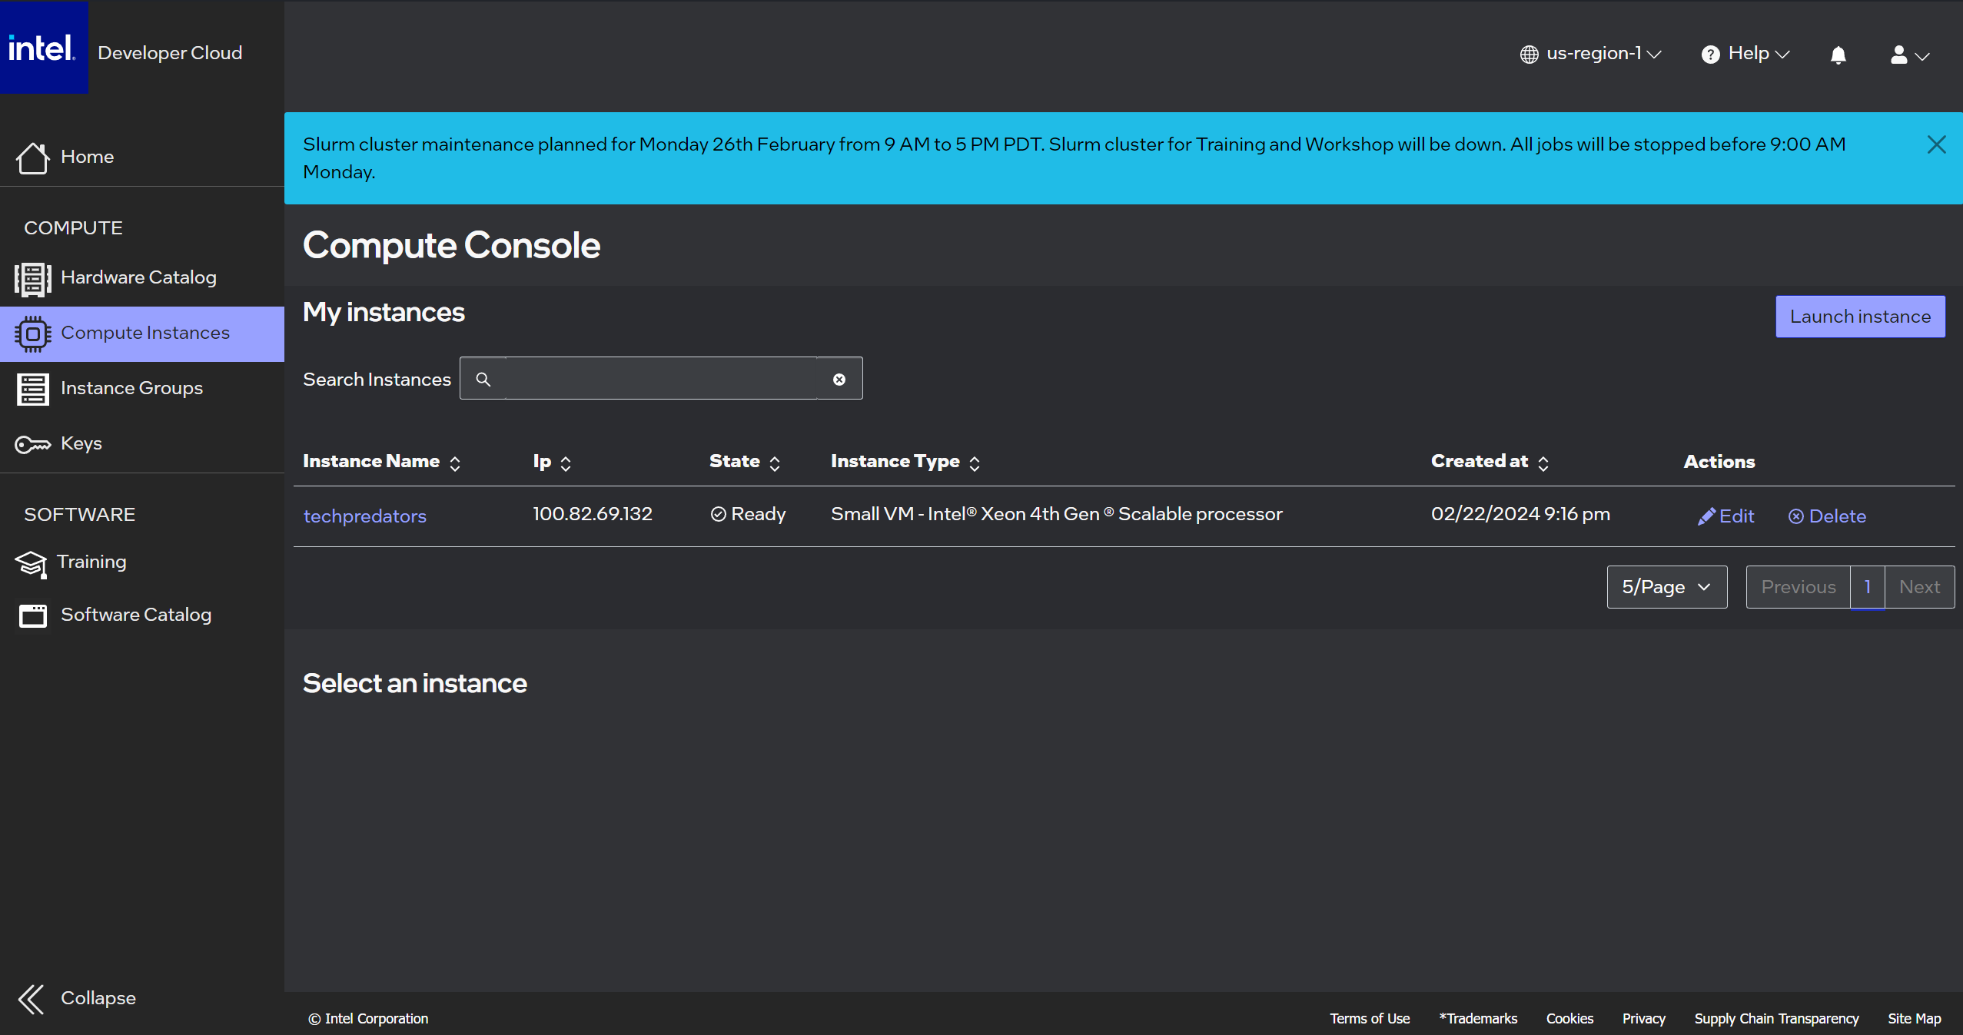
Intel® Developer Cloud Account (Screenshot)

Slide 9
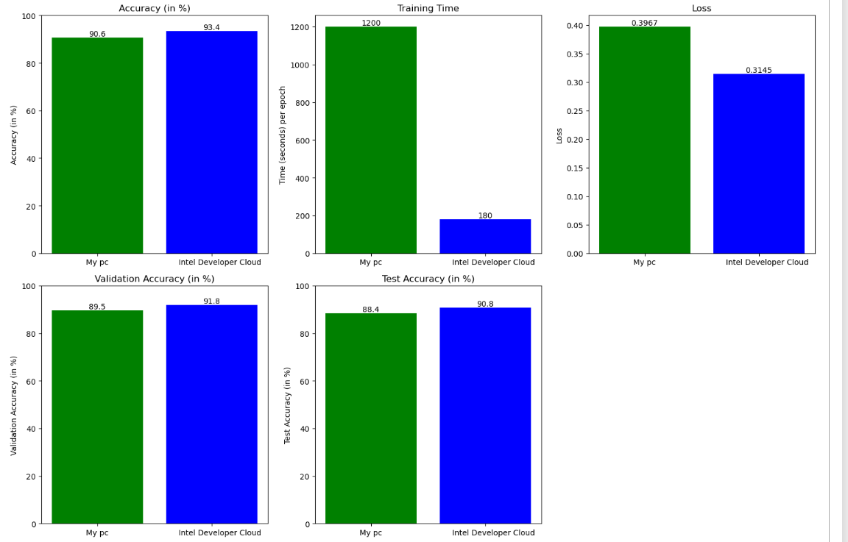
Use case of Intel® Developer Cloud (IDC)
Intel Developer Cloud can play a pivotal role in addressing the challenges outlined in the scenario of agricultural productivity and plant disease detection.
High-Performance Computing (HPC): The Intel Developer Cloud offers access to powerful computing resources, including high-performance CPUs and accelerators like Intel Xeon processors and Intel FPGA. These resources can be leveraged to develop and deploy complex machine-learning models for plant disease detection.
Scalability: With Intel Developer Cloud, agricultural organizations can scale their computational resources based on demand. This scalability is crucial for handling large datasets and performing intensive computational tasks required for training and optimizing machine learning algorithms for disease detection.
Personal use case:- Reduced model training time by a factor of 6.66, increase in accuracy, decrease in lose value,etc.

Slide 10
Thank you so much!

